Slide 1

Learning Objective
I will be able to expand, factorise and solve quadratic equations
Enter quietly, please be ready with the following on your desk:
Whiteboard
Whiteboard marker
Exercise Book
Pencil, pen, ruler and red pen
Diary
Calculator (Scientific and ClassPad)
Device – charged or borrowed from Library before maths

Slide 2
Learning Objective
CFU
What will we learn today?
I will be able to expand, factorise and solve quadratic equations
CFU
How will you know that you are successful?
Success Criteria
At the end of the lesson, I will be able to:
Expand using distributive law and FOIL
Factorise quadratic equations
Solve quadratic equations

Slide 3
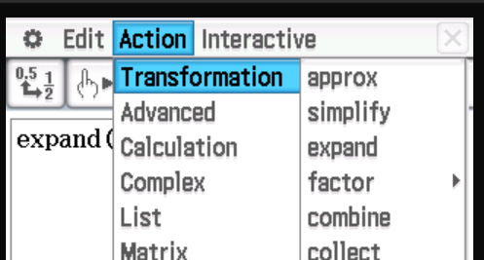
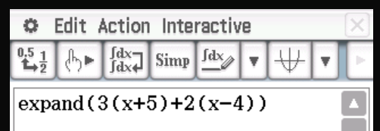
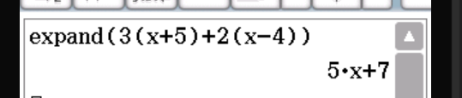
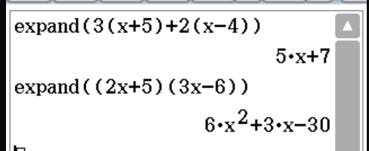


Expand - Main
This function can be used in Main
Select Action > Transformation> Expand
Type in $3(x + 5) + 2(x – 4)$
Select “EXE”
Try it for $(2x+5)(3x−6)$

Slide 4
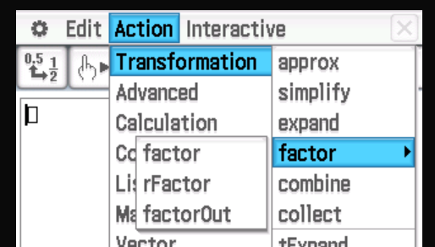
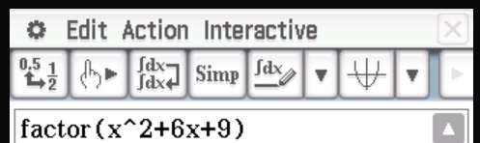
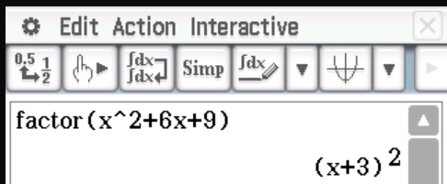
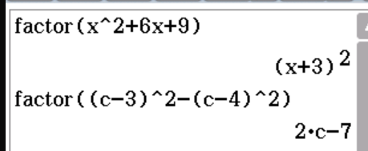


Expand - Main
This function can be used in Main
Select Action > Transformation> Factor > Factor
Type in $x2 + 6x +9$
Select “EXE”
Try it for$(c−3)2 − (c+4)2$

Slide 5
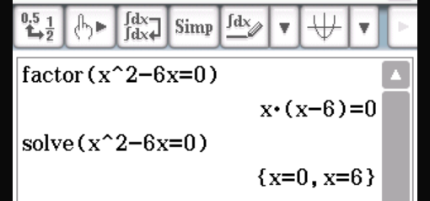
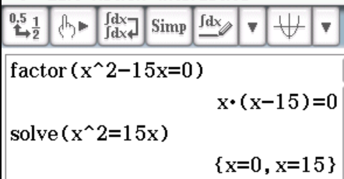




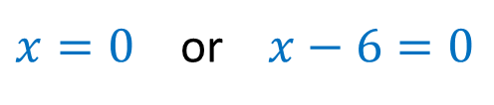
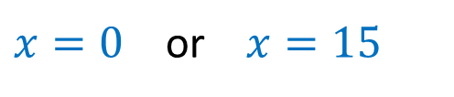

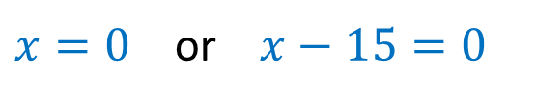

Solving - Main
$$x^{2}−6x=0$$
$$x^{2}=15x$$
$$x\left(x−6\right)=0$$
$$x^{2}−15x=0$$
$$x(x−15)=0$$
$x=0$ or $x−6=0$
$x=0$ or $x−15=0$
$x=0$ or $x=6$
$x=0$ or $x=15$

